Slide 1
Road Accident Analysis & Prevention
By Aditya | IGNOU | Professional Project

Slide 2
Problem Statement
Road accidents are one of the major causes of death and injuries globally. The aim of this project is to analyze accident data to find the root causes, patterns, and correlations that can help reduce future incidents.

Slide 3
Objectives
• Identify key factors influencing road accidents
• Detect accident hotspots using geographic data
• Predict accident severity using ML models
• Propose preventive measures for road safety improvement

Slide 4
Dataset Description
• Dataset: Road Accident Data (cleaned)
• Features: Weather, Light, Road Type, Speed Limit, Casualties, etc.
• Missing values handled and formats standardized
• Size: 1M+ records

Slide 5
Exploratory Data Analysis (EDA)
• Accident trend by time, day, and weather
• Severity distribution across locations
• Relationship between speed limit and casualties
• Identification of hotspots using lat-long data

Slide 6
Machine Learning Model
Model Used: Random Forest Classifier
Target Variable: Accident Severity
Features: Speed Limit, Weather, Light Conditions, Road Type, etc.
Performance Metrics:
• Accuracy: 85%
• Precision: 83%
• Recall: 84%

Slide 7
Key Insights
• Most accidents occur between 5 PM - 8 PM
• Poor lighting and wet roads increase severity
• Urban regions show higher frequency
• Speeding is the top cause of severe accidents

Slide 8
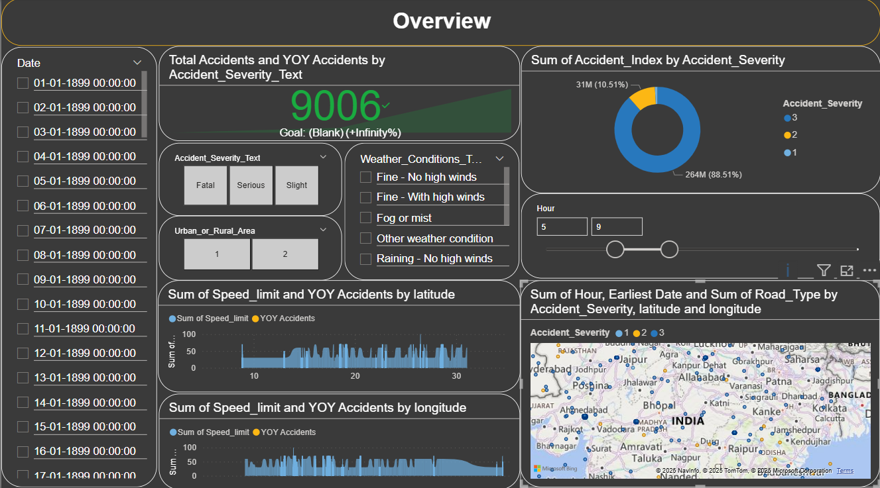
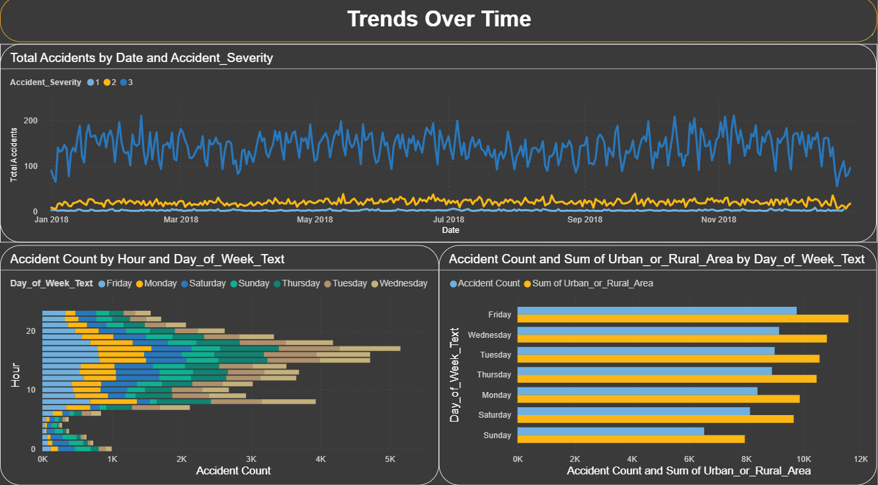
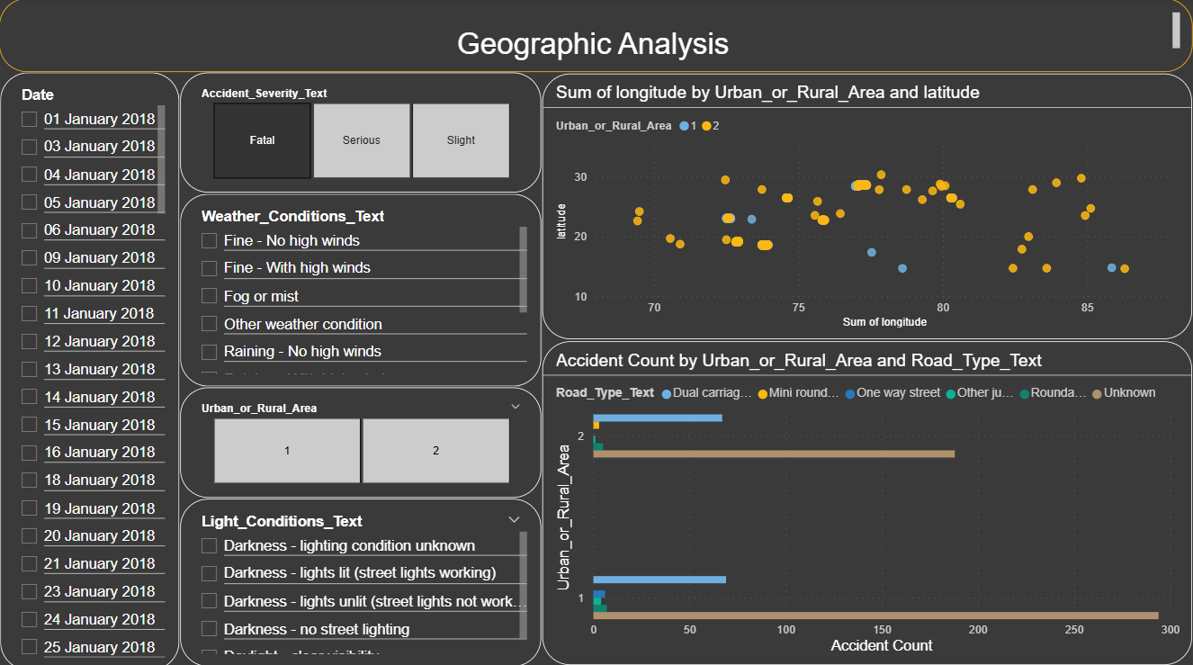
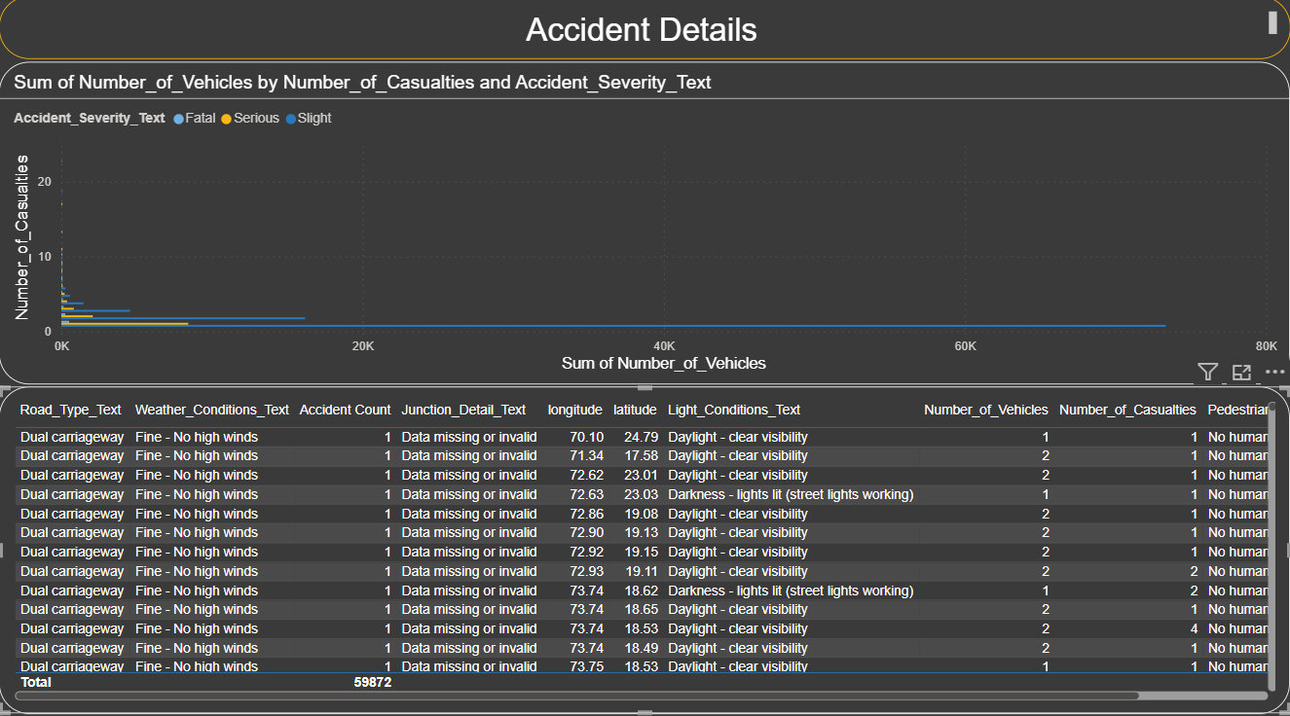
Power BI

Slide 9
Recommendations
• Strengthen enforcement of speed limits
• Enhance lighting in accident-prone zones
• Public campaigns for safe driving
• Real-time traffic alerts based on weather data

Slide 10
Future Scope
• IoT integration for live traffic monitoring
• AI-based real-time accident risk prediction
• Larger dataset inclusion for global analysis
• Collaboration with authorities for policy improvement

Slide 11
Conclusion
This project showcases how data analysis and machine learning can drive road safety improvements. Through identifying key accident factors and predicting severity, we can proactively reduce fatalities and make roads safer.

